Slide 1

Recommender System
Using
Collaborative Filtering
SK Broadband x Sungkyunkwan University
문경진
구자현

Slide 2

CONTENTS
Recommender System
Collaborative Filtering
Challenges

Slide 3
Recall : GOAL OF PROJECT
Making recommender system for viewers at particular time periods in succession to previous research
To achieve our goal, we will use watching data of IPTV users.

Slide 4
Recall : MAIN TASK
Clustering watching data, using K-means algorithm and K-NN
Implement recommender system using collaborative filtering
Performance checking, drawing conclusion

Slide 5
Definition : Recommender System
Subclass of information filtering system that seeks to predict the rating or preference a user would give to an item
Several approaches
Content-based
Collaborative Filtering
Hybrid

Slide 6
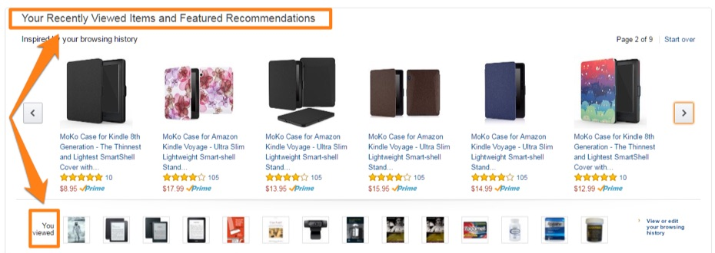
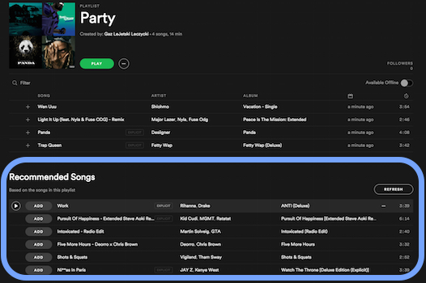
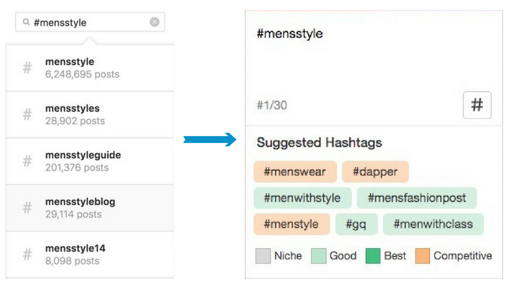
Examples

Slide 7
Definition : Collaborative Filtering
Collaborative Filtering
Based on similar users, the recommendation system effectively recommend the items that the target user has not evaluated.
Notes:
<overall procedure 그림 넣기>

Slide 8






Example of CF
?

Slide 9
How to Recommend?
Using user-item matrix
Represent the relationship between users and items
explicit / implicit
 | Item 1 | Item 2 | Item 3 | Item 4 | Item 5
A | 5 | 3 | 4 | 4 | ?
B | 3 | 1 | 2 | 2 | 2
C | 4 | 3 | 4 | 3 | 5
D | 3 | 3 | 1 | 5 | 4
E | 1 | 5 | 5 | 2 | 1

Slide 10
3 Steps
Measuring similarity
How to measure?
Selecting neighborhood
How many neighbors?
Aggregating ratings
How to make a prediction?

Slide 11
Step 1. Measuring Similarity
If the range of data is different, normalize it.
Mean-centering, Z-score normalization
Using similarity measure
Pearson correlation coefficient, cosine similarity

Slide 12
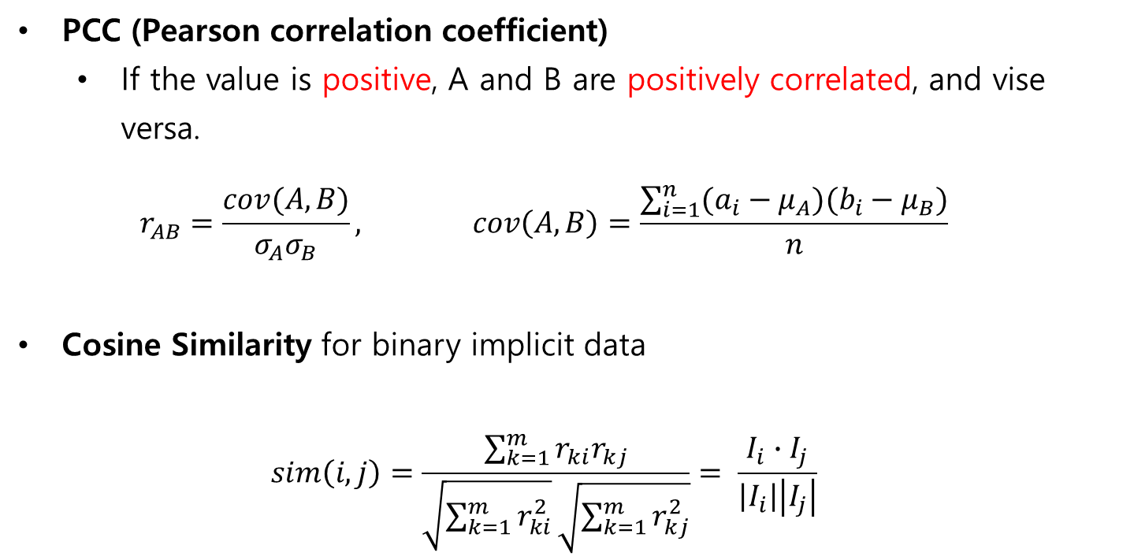
Step 1. Measuring Similarity
PCC (Pearson correlation coefficient)
If the value is positive, A and B are positively correlated, and vise versa.
$$r_{AB}=\frac{cov(A,B)}{σ_{A}σ_{B}}, cov\left(A,B\right)=\frac{\sum_{i=1}^{n}{(a_{i}−μ_{A})(b_{i}−μ_{B})}}{n}$$
Cosine Similarity for binary implicit data
$$sim\left(i,j\right)=\frac{\sum_{k=1}^{m}{r_{ki}r_{kj}}}{\sqrt{\sum_{k=1}^{m}{r_{ki}^{2}}}\sqrt{\sum_{k=1}^{m}{r_{kj}^{2}}}}= \frac{I_{i}∙I_{j}}{\left|I_{i}\right|\left|I_{j}\right|}$$

Slide 13

Step 1. Measuring Similarity
$$r_{AB}=\frac{cov(A,B)}{σ_{A}σ_{B}}, cov\left(A,B\right)=\frac{\sum_{i=1}^{n}{(a_{i}−μ_{A})(b_{i}−μ_{B})}}{n}$$
 | Item 1 | Item 2 | Item 3 | Item 4 | Item 5
A | 5 | 3 | 4 | 4 | ?
B | 3 | 1 | 2 | 2 | 2
C | 4 | 3 | 4 | 3 | 5
D | 3 | 3 | 1 | 5 | 4
E | 1 | 5 | 5 | 2 | 1
Sim(A,B) | 1.0
Sim(A,C) | 0.6
Sim(A,D) | 0.0
Sim(A,E) | -0.77

Slide 14
Step 2. Selecting Neighborhood
Pick N similar users
Based on similarity
With positive similarities
With top-N neighbors sorted by similarity

Slide 15

Step 2. Selecting Neighborhood
$\text{Pick} \text{N} \text{similar} \text{users}$
$\text{With} \text{top}\text{−2 }\text{neighbors} \text{sorted} \text{by} \text{similarity}$
 | Item 1 | Item 2 | Item 3 | Item 4 | Item 5
A | 5 | 3 | 4 | 4 | ?
B | 3 | 1 | 2 | 2 | 2
C | 4 | 3 | 4 | 3 | 5
D | 3 | 3 | 1 | 5 | 4
E | 1 | 5 | 5 | 2 | 1
Sim(A,B) | 1.0
Sim(A,C) | 0.6
Sim(A,D) | 0.0
Sim(A,E) | -0.77

Slide 16

Step 3. Make Prediction
Weighted average + bias
$$prediction\left(u, i\right)=μ_{u}+\frac{\sum_{v∈N}{sim\left(u, v\right)∗(r_{vi}−μ_{u})}}{\sum_{v∈N}{sim\left(u, v\right)}}$$
Weighted average : similar users have more impact

Slide 17

Step 3. Make Prediction
$$prediction\left(u, i\right)=μ_{u}+\frac{\sum_{v∈N}{sim\left(u, v\right)∗(r_{vi}−μ_{u})}}{\sum_{v∈N}{sim\left(u, v\right)}}$$
$$=4.0+\frac{1.0∗0.0+0.6∗1.2}{1.0+0.6}=4.45$$
 | Item 1 | Item 2 | Item 3 | Item 4 | Item 5
A | 5 | 3 | 4 | 4 | 4.45
B | 3 | 1 | 2 | 2 | 2
C | 4 | 3 | 4 | 3 | 5
D | 3 | 3 | 1 | 5 | 4
E | 1 | 5 | 5 | 2 | 1
Sim(A,B) | 1.0
Sim(A,C) | 0.6
Sim(A,D) | 0.0
Sim(A,E) | -0.77

Slide 18

Using Recommender System Tools
from surprise import KNNBasic,Dataset
data = Dataset.load_builtin('ml-100k')
trainset = data.build_full_trainset()
algo = KNNBasic() #basic recommender system algorithm
algo.fit(trainset)
uid = str(108)
iid = str(408)
pred = algo.predict(uid, iid, r_ui=4, verbose=True)

Slide 19
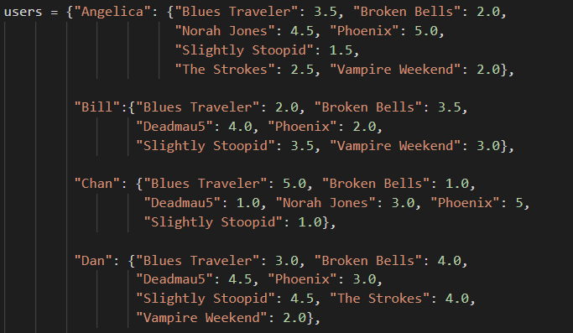
Toy Code

Slide 20
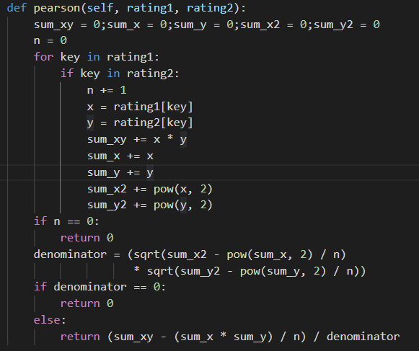
Toy Code

Slide 21
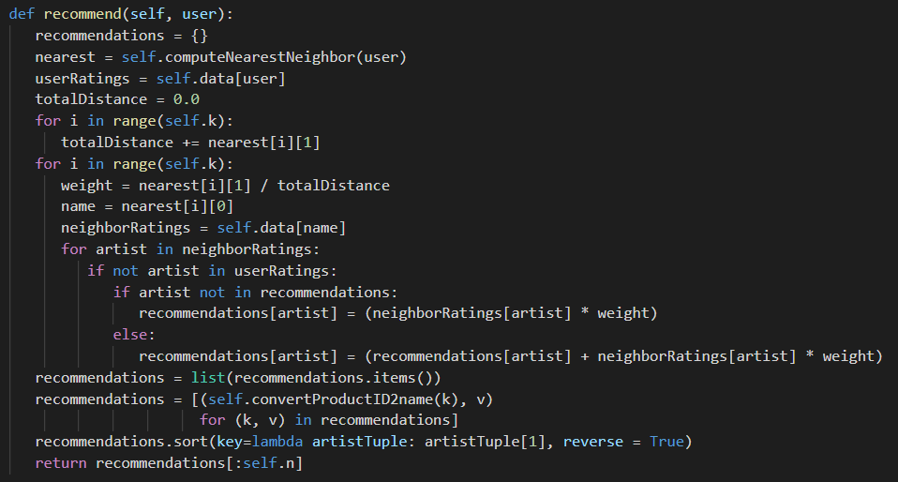
Toy Code

Slide 22
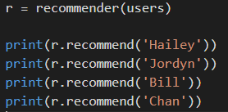

Toy Code

Slide 23
Challenges
1. Data Sparsity
2. Scalability
3. Synonyms
4. Gray Sheep / Black Sheep
5. Shilling Attacks
6. Diversity

Slide 24
Challenges
1. Data Sparsity
 | Movie1 | Movie2 | Movie3 | Movie4 | Movie5 | Movie6 | Movie7 | Movie8 | Movie9
User1 |  | 5 |  |  | 4.5 | 3
User2 |  |  | 4.5
new

Slide 25
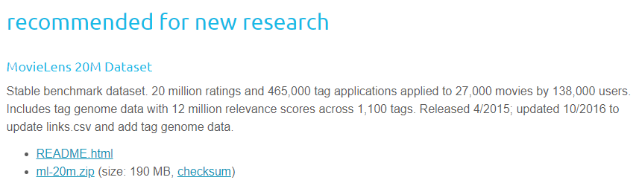
Challenges
2. Scalability

Slide 26
Challenges
3. Synonyms
Synonyms refers to the tendency of a number of the same or very similar items to have different names or entries.
Most recommender systems are unable to discover this latent association and thus treat these products differently.
ex) Children film != Children movie

Slide 27
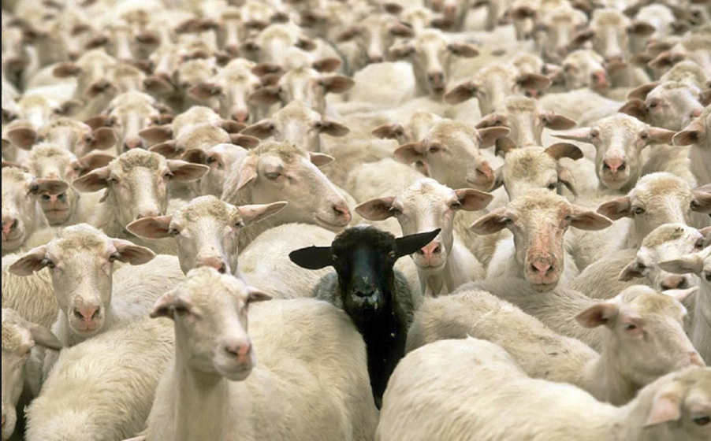
Challenges
4. Gray Sheep / Black Sheep
Black sheep are the group whose idiosyncratic tastes make recommendations nearly impossible
Gray sheep is the opposite

Slide 28
Challenges
5. Shilling Attacks
Malicious users may influence the system by inserting biased data into the system, in order to push the prediction of some targeted items.
Agents called shills are hired to manipulate the system by giving false opinion.
Such attacks may mess up the objectivity and accuracy of the system.

Slide 29
Challenges
6. Diversity
Collaborative filters are expected to increase diversity because they help us discover new products.
Some algorithms, however, may unintentionally do the opposite.
This can lead to rich-get-richer, poor get poorer effect

Slide 30
SUMMARY
Recommender System
Collaborative Filtering
Challenges

Slide 31
CHECKPOINT
Deep Learning in recommender system?
How to find appropriate N value in CF?

Slide 32
FINISH
OUR PRESENTATION THANK YOU

